Slide 1
Capstone Course Project
Title:
Comparing Brough and Neighborhoods for Manhattan, NY and Toronto, CA
By Rahel Tessema
05/06/20

Slide 2
Problem and Background
Toronto and New York are the famous places in North America. They are diverse in many ways. Both are multicultural as well as the financial hubs of their respective countries.
The purpose of this project is to explore how much they are similar or dissimilar in aspects from a tourist point of view regarding food, accommodation, beautiful places, and many more

Slide 3
Description
Foursquare API service is used to explore the data of two cities, in terms of their neighborhoods.
The data also include the information about the places around each neighborhood like restaurants, hotels, coffee shops, parks, theaters, art galleries, museums and many more.

Slide 4
METHODOLOGY
The Borough of the two cities were selected to explore their neighborhoods. The data exploration, analysis and visualization for both boroughs are done in the same way but separately.
EXPLORATION
For Downtown Toronto case, The table was extracted of Toronto’s Borough from Wikipedia page(https://en.wikipedia.org/wiki/List_of_postal_codes_of_Canada:_M).
For Manhattan, https://geo.nyu.edu/catalog/nyu_2451_34572

Slide 5
ANALYSIS
The boroughs and neighborhoods was analyzed through one hot encoding (giving ‘1’ if a venue category is there, and ‘0’ in case of venue category is not there).
The mean of the frequency of occurrence of each category was calculated and picked top five venues on that basis for each neighborhood.

Slide 6
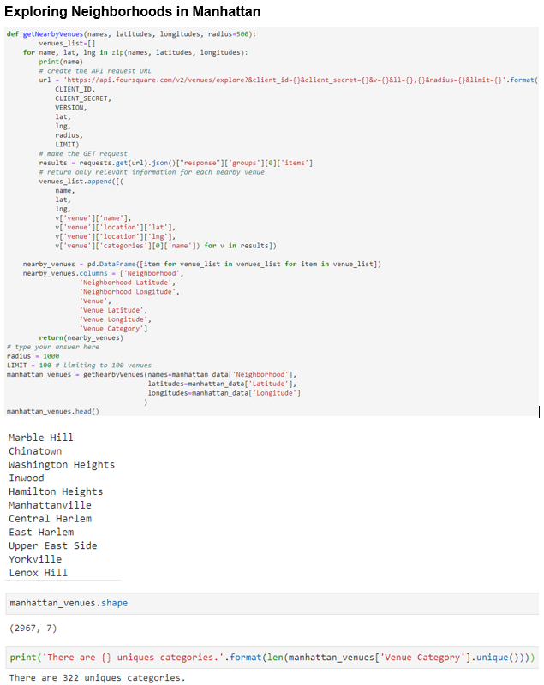
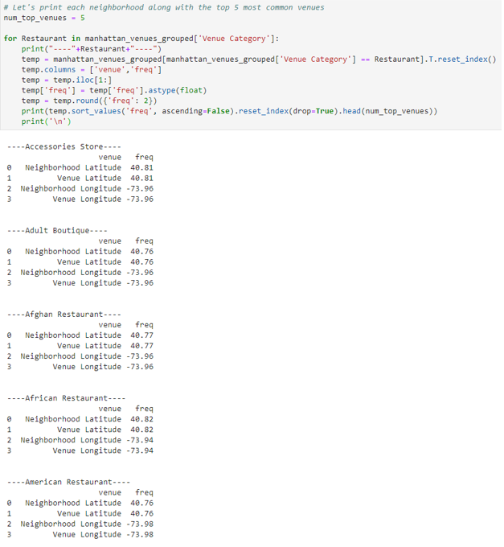

Slide 7
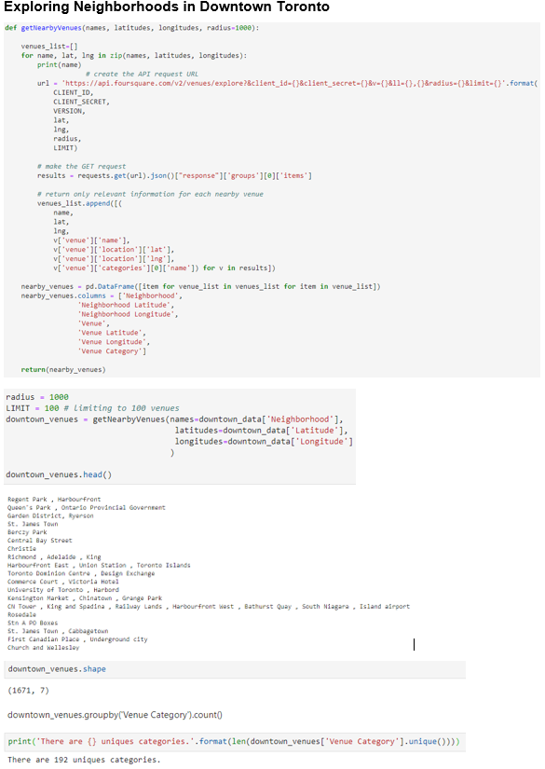
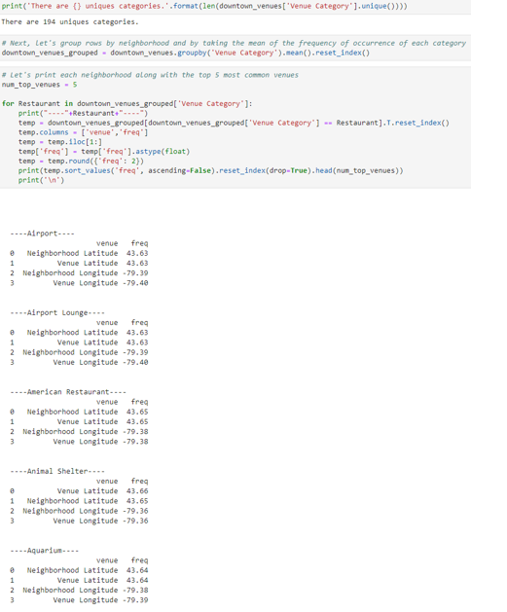

Slide 8
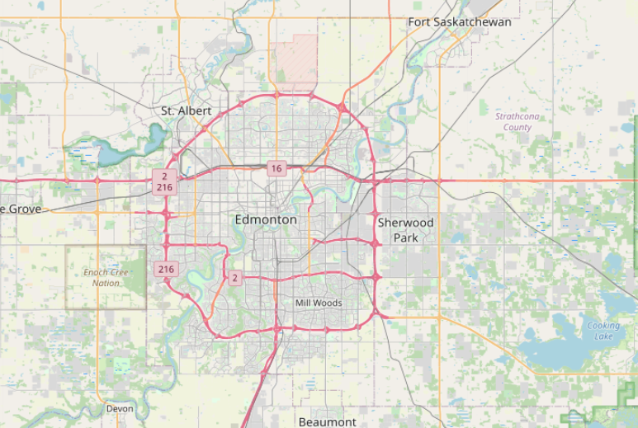
Toronto, CA

Slide 9
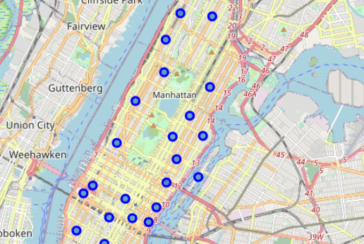
Manhattan, NY

Slide 10
Conclusion
Based on the number of neighborhoods and brought Analysis Manhattan has 2967 Neighborhoods and 7 Borough with 322 unique categories whereas Toronto has 1671 Neighborhoods and 7 Borough & 194 Unique categories.
Recommendation
Based the number of unique Categories Manhattan has a lot of places to visit than Toronto. SO I recommend for the Tourist to visit this place and in order to be exposed with various new things they haven’t exposed before.

Slide 11
Thank You!

